Slide 2
Objectives Overview
Define the term, computer security risks, and briefly describe the types of cybercrime perpetrators
Discuss techniques to prevent unauthorized computer access and use
Identify safeguards against hardware theft and vandalism
Explain the ways software manufacturers protect against software piracy
Discuss how encryption works, and explain why it is necessary
Describe various types of Internet and network attacks, and identify ways to safeguard against these attacks
See Page 555
for Detailed Objectives

Slide 3
Objectives Overview
Discuss the types of devices available that protect computers from system failure
Explain the options available for backing up computer resources
Identify risks and safeguards associated with wireless communications
Discuss ways to prevent health-related disorders and injuries due to computer use
Recognize issues related to information accuracy, intellectual property rights, codes of conduct, and green computing
Discuss issues surrounding information privacy
See Page 555
for Detailed Objectives

Slide 4
Computer Security Risks
A computer security risk is any event or action that could cause a loss of or damage to computer hardware, software, data, information, or processing capability
A cybercrime is an online or Internet-based illegal act
Hackers
Crackers
Script Kiddies
Corporate Spies
Unethical Employees
Cyberextortionists
Cyberterrorists
Pages 556 - 557

Slide 5
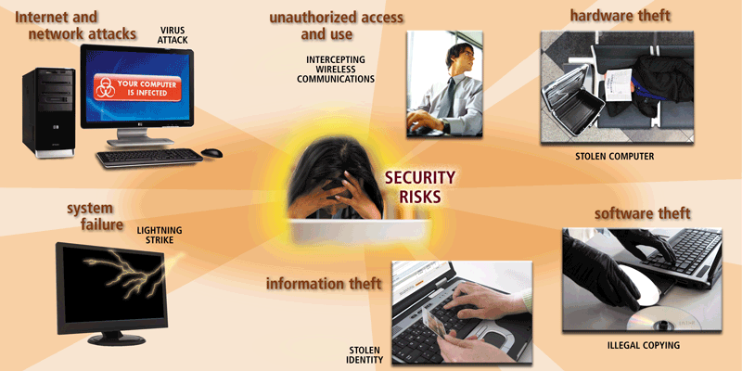
Computer Security Risks
Pages 556 – 557
Figure 11-1

Slide 6
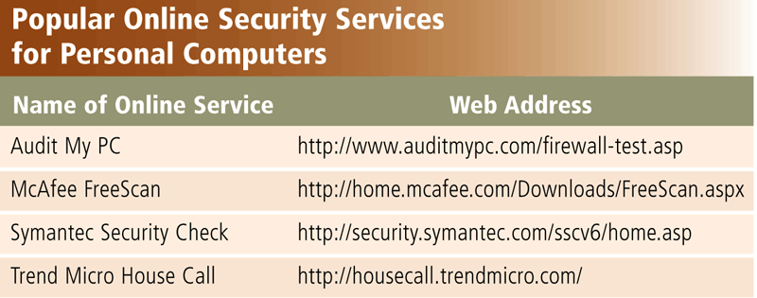
Internet and Network Attacks
Information transmitted over networks has a higher degree of security risk than information kept on an organization’s premises
An online security service is a Web site that evaluates your computer to check for Internet and e-mail vulnerabilities
Page 558
Figure 11-2

Slide 7
Internet and Network Attacks
Computer Virus
Affects a computer negatively by altering the way the computer works
Worm
Copies itself repeatedly, using up resources and possibly shutting down the computer or network
Trojan Horse
A malicious program that hides within or looks like a legitimate program
Rootkit
Program that hides in a computer and allows someone from a remote location to take full control
Page 558

Slide 8
Internet and Network Attacks
An infected computer has one or more of the following symptoms:
Operating system runs much slower than usual
Available memory is less than expected
Files become corrupted
Screen displays unusual message or image
Music or unusual sound plays randomly
Existing programs and files disappear
Programs or files do not work properly
Unknown programs or files mysteriously appear
System properties change
Operating system does not start up
Operating system shuts down unexpectedly
Pages 558 - 559

Slide 9
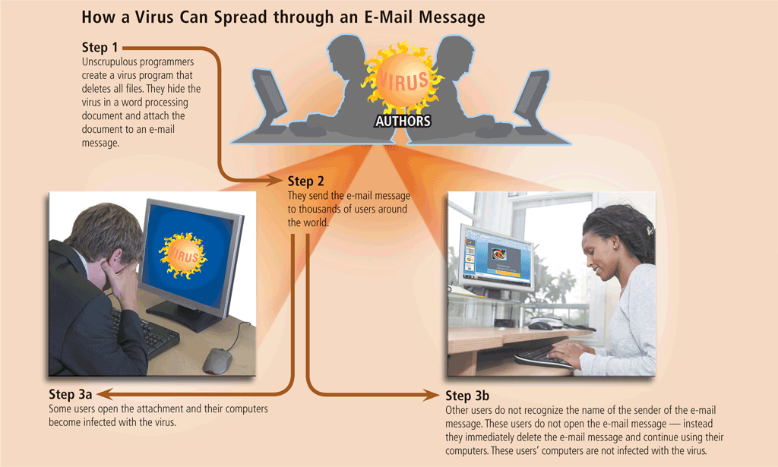
Internet and Network Attacks
Page 559
Figure 11-3

Slide 10
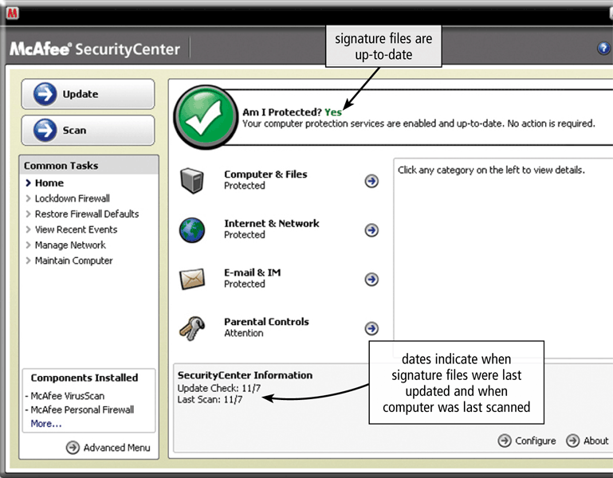
Internet and Network Attacks
Page 561
Figure 11-6

Slide 11
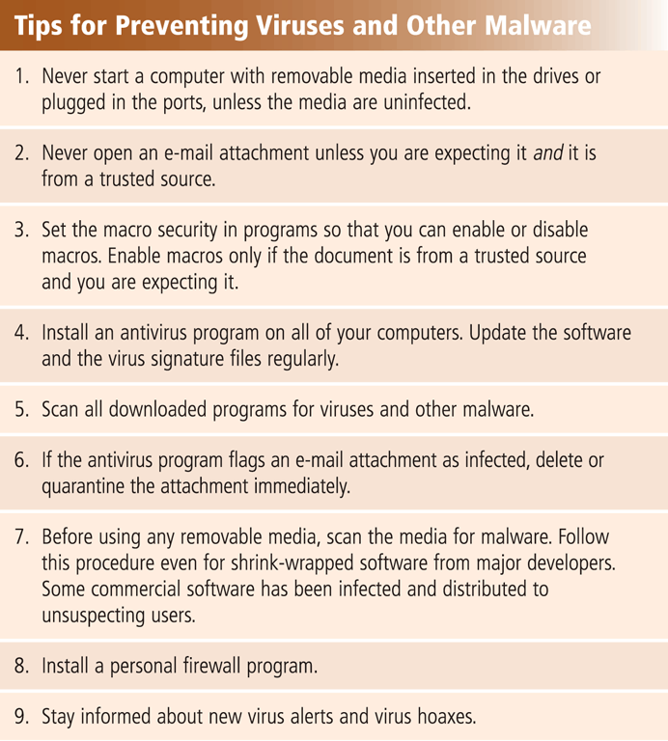
Internet and Network Attacks
Users can take several precautions to protect their home and work computers and mobile devices from these malicious infections
Page 560 – 561
Figure 11-7

Slide 12
Internet and Network Attacks
A botnet is a group of compromised computers connected to a network
A compromised computer is known as a zombie
A denial of service attack (DoS attack) disrupts computer access to Internet services
Distributed DoS (DDoS)
A back door is a program or set of instructions in a program that allow users to bypass security controls
Spoofing is a technique intruders use to make their network or Internet transmission appear legitimate
Pages 562 - 563

Slide 13
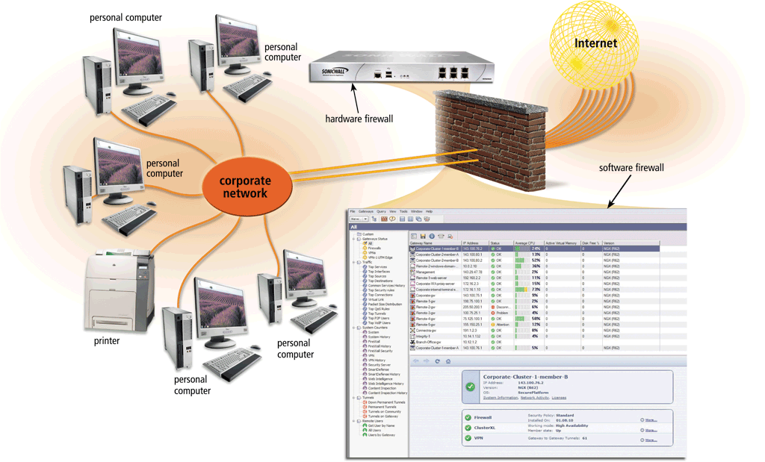
Internet and Network Attacks
A firewall is hardware and/or software that protects a network’s resources from intrusion
Pages 563 - 564
Figure 11-8

Slide 14
Internet and Network Attacks
Intrusion detection software
Analyzes all network traffic
Assesses system vulnerabilities
Identifies any unauthorized intrusions
Notifies network administrators of suspicious behavior patterns or system breaches
Honeypot
Vulnerable computer that is set up to entice an intruder to break into it
Page 564

Slide 15
Unauthorized Access and Use
Unauthorized access is the use of a computer or network without permission
Unauthorized use is the use of a computer or its data for unapproved or possibly illegal activities
Page 564

Slide 16
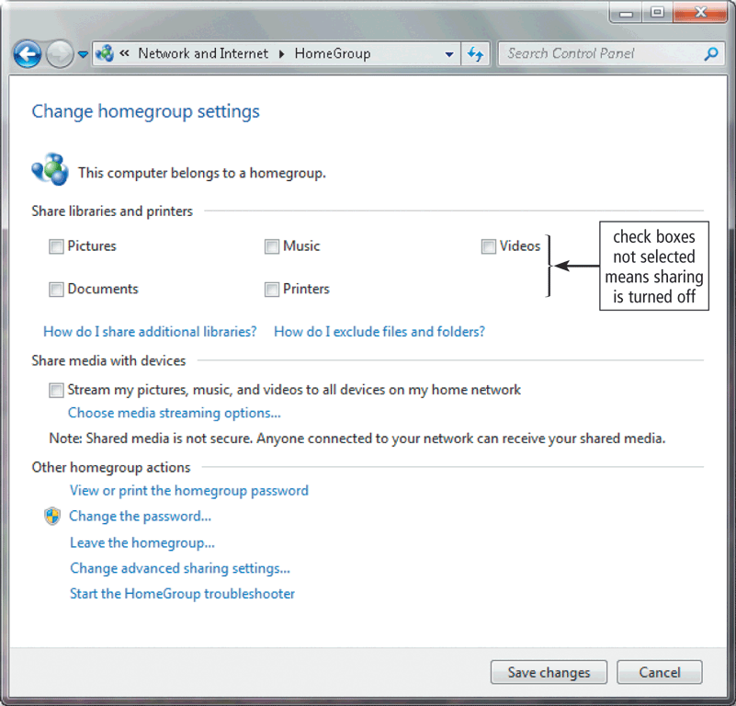
Unauthorized Access and Use
Organizations take several measures to help prevent unauthorized access and use
Acceptable use policy
Disable file and printer sharing
Firewalls
Intrusion detection software
Page 565
Figure 11-10

Slide 17
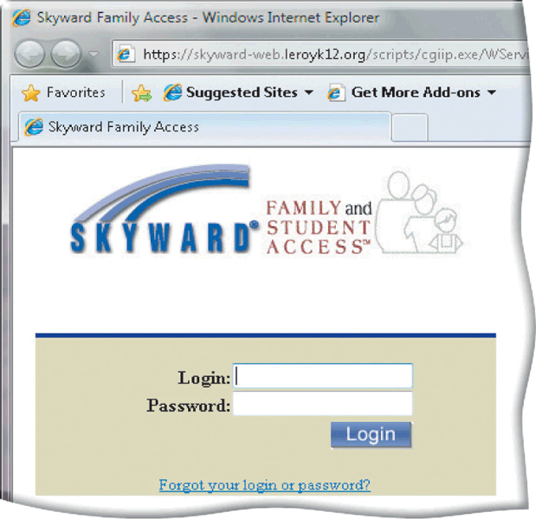
Unauthorized Access and Use
Access controls define who can access a computer, when they can access it, and what actions they can take
Two-phase processes called identification and authentication
User name
Password
Passphrase
CAPTCHA
Pages 565 – 567
Figure 11-11

Slide 18
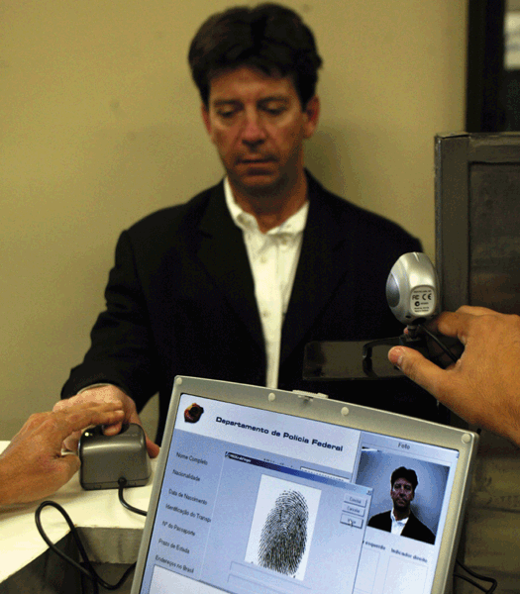
Unauthorized Access and Use
A possessed object is any item that you must carry to gain access to a computer or computer facility
Often are used in combination with a personal identification number (PIN)
A biometric device authenticates a person’s identity by translating a personal characteristic into a digital code that is compared with a digital code in a computer
Page 568
Figure 11-14

Slide 19
Unauthorized Access and Use
Digital forensics is the discovery, collection, and analysis of evidence found on computers and networks
Many areas use digital forensics
Law enforcement
Criminal prosecutors
Military intelligence
Insurance agencies
Information security departments
Page 569

Slide 20
Hardware Theft and Vandalism
Hardware theft is the act of stealing computer equipment
Hardware vandalism is the act of defacing or destroying computer equipment
Page 570

Slide 21
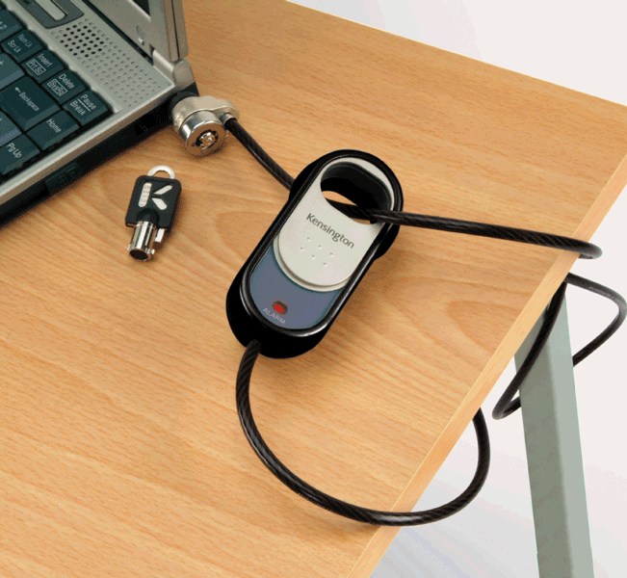
Hardware Theft and Vandalism
To help reduce the of chances of theft, companies and schools use a variety of security measures
Physical access controls
Alarm systems
Cables to lock equipment
Real time location system
Passwords, possessed objects, and biometrics
Page 570
Figure 11-15

Slide 22
Software Theft
Software theft occurs when someone:
Steals software media
Intentionally erases programs
Illegally copies a program
Illegally registers and/or activates a program
Page 571

Slide 23
Software Theft
A single-user license agreement typically contains the following conditions:
Permitted to
Install the software on one computer
Not permitted to
Install the software on a network
Make one copy of the software
Remove the software from your computer before giving it away or selling it
Give copies to friends or colleagues while continuing to use the software
Export the software
Rent or lease the software
Page 571

Slide 24
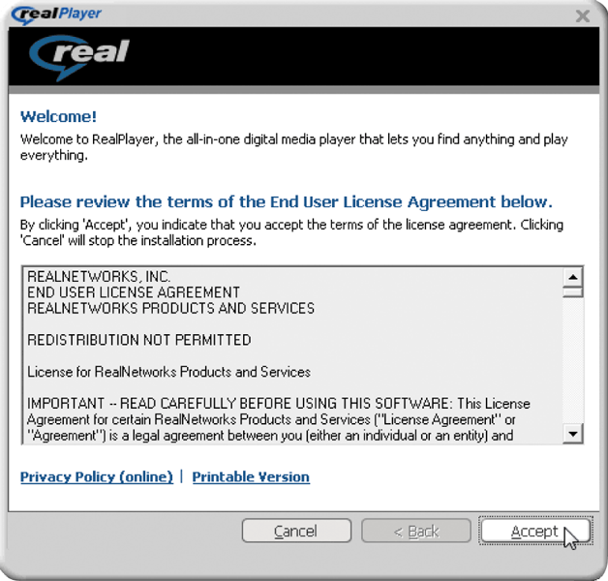
Software Theft
Copying, loaning, borrowing, renting, or distributing software can be a violation of copyright law
Some software requires product activation to function fully
Pages 571 – 572
Figure 11-16

Slide 25
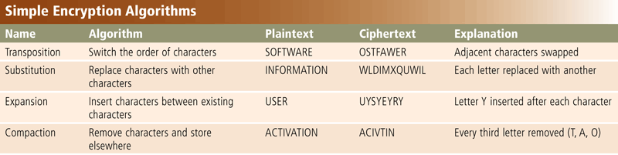
Information Theft
Information theft occurs when someone steals personal or confidential information
Encryption is a process of converting readable data into unreadable characters to prevent unauthorized access
Pages 572 - 573
Figure 11-17

Slide 26
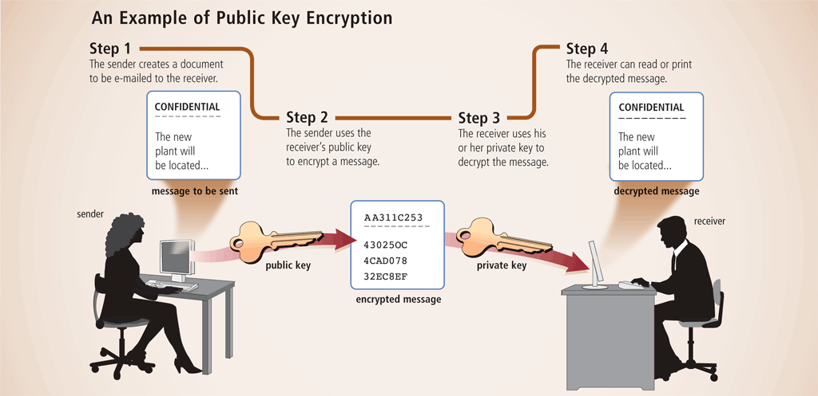
Information Theft
Page 573
Figure 11-18

Slide 27
Information Theft
A digital signature is an encrypted code that a person, Web site, or organization attaches to an electronic message to verify the identity of the sender
Often used to ensure that an impostor is not participating in an Internet transaction
Web browsers and Web sites use encryption techniques
Page 574

Slide 28
Information Theft
Popular security techniques include
Digital Certificates
Transport Layer Security (TLS)
Secure HTTP
VPN
Pages 574 - 575

Slide 29
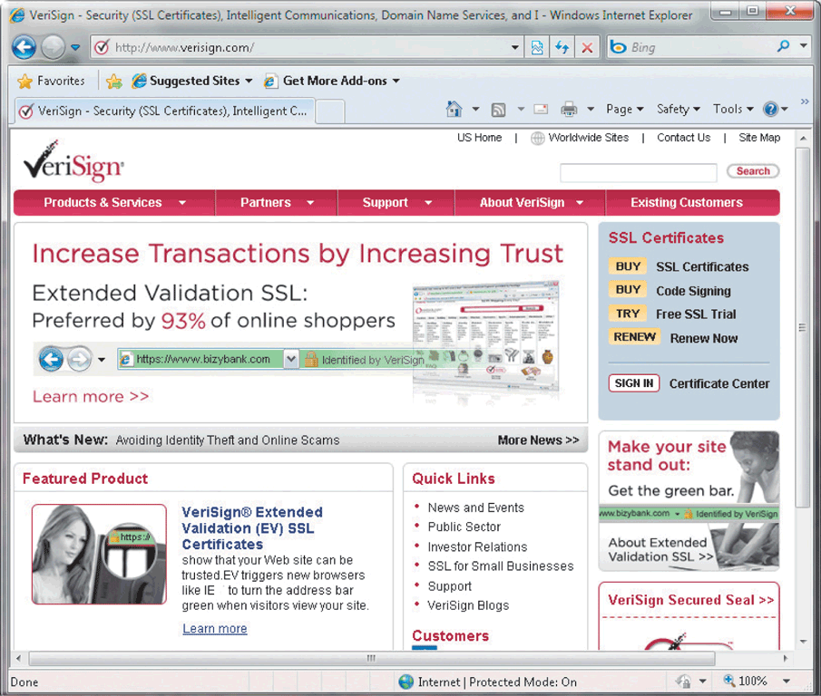
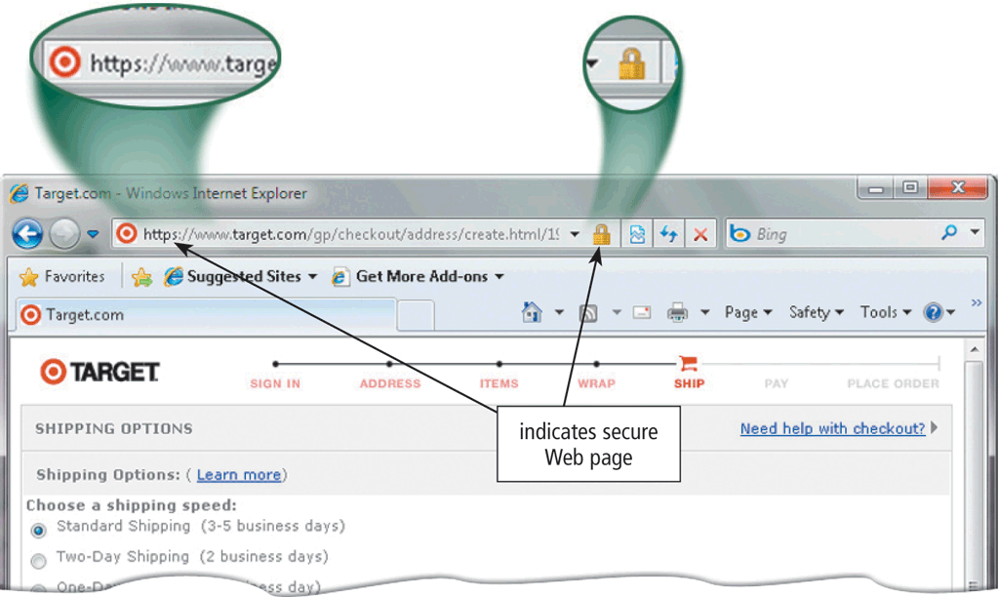
Information Theft
Pages 574 - 575
Figures 11-19 – 11-20

Slide 30
System Failure
A system failure is the prolonged malfunction of a computer
A variety of factors can lead to system failure, including:
Aging hardware
Natural disasters
Electrical power problems
Noise, undervoltages, and overvoltages
Errors in computer programs
Page 575

Slide 31
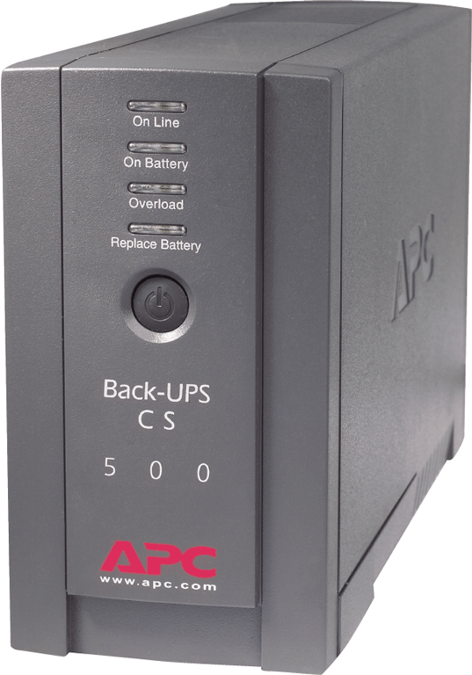
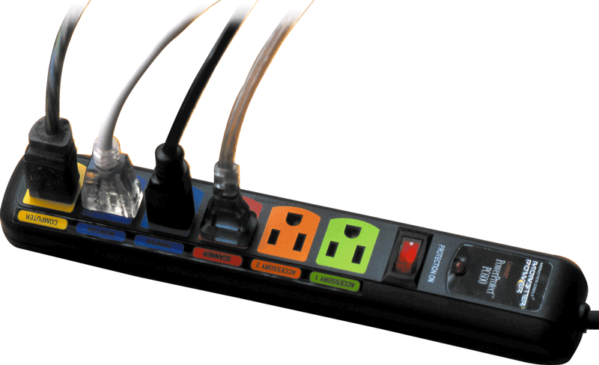
System Failure
Two ways to protect from system failures caused by electrical power variations include surge protectors and uninterruptable power supplies (UPS)
Page 576
Figures 11-21 – 11-22

Slide 32
Backing Up – The Ultimate Safeguard
A backup is a duplicate of a file, program, or disk that can be used if the original is lost, damaged, or destroyed
To back up a file means to make a copy of it
Offsite backups are stored in a location separate from the computer site
Cloud Storage
Page 577

Slide 33
Backing Up – The Ultimate Safeguard
Two categories of backups:
Full backup
Selective backup
Three-generation backup policy
Grandparent
Parent
Child
Page 577

Slide 34
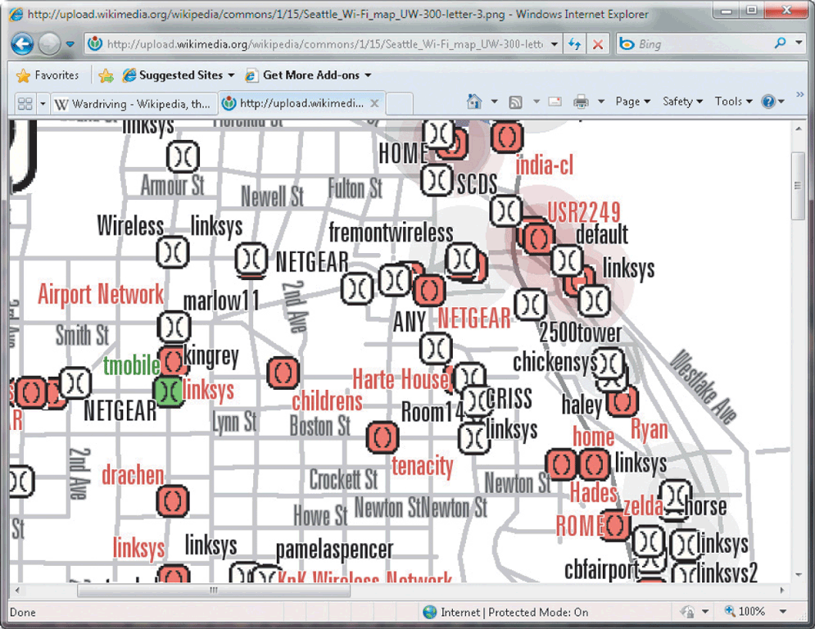
Wireless Security
Wireless access poses additional security risks
About 80 percent of wireless networks have no security protection
War driving allows individuals to detect wireless networks while driving a vehicle through the area
Page 578
Figure 11-23

Slide 35
Wireless Security
In additional to using firewalls, some safeguards improve security of wireless networks:
A wireless access point should not broadcast an SSID
Change the default SSID
Configure a WAP so that only certain devices can access it
Use WPA or WPA2 security standards
Page 578

Slide 36
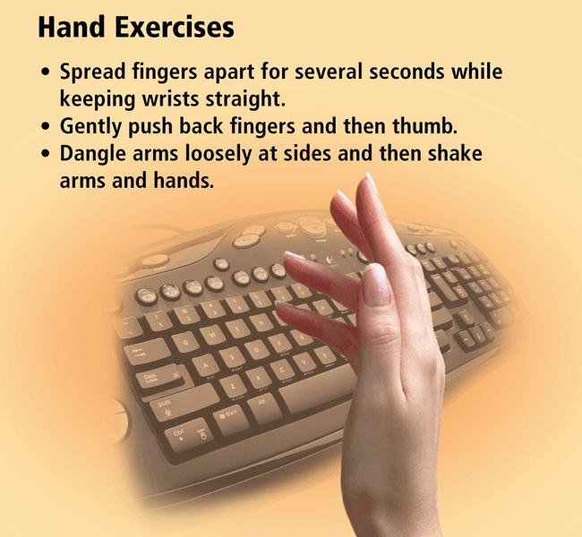
Health Concerns of Computer Use
The widespread use of computers has led to health concerns
Repetitive strain injury (RSI)
Tendonitis
Carpal tunnel syndrome (CTS)
Computer vision syndrome (CVS)
Page 579
Figure 11-24

Slide 37
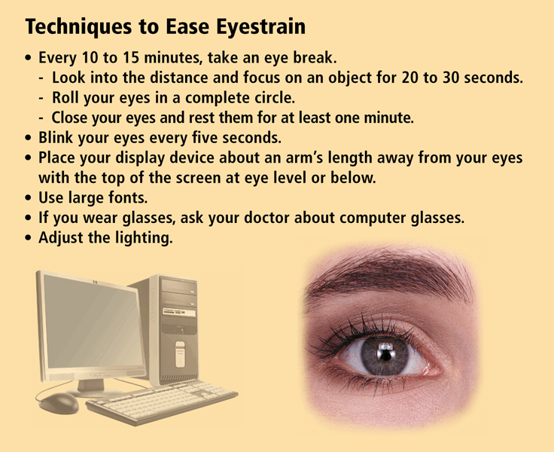
Health Concerns of Computer Use
Page 580
Figure 11-25

Slide 38
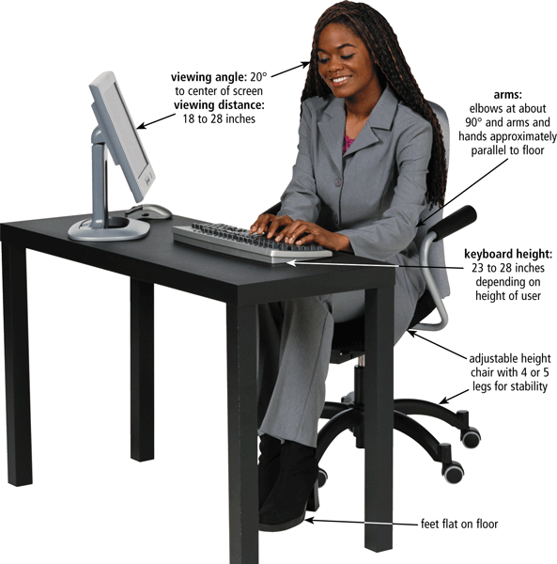
Health Concerns of Computer Use
Ergonomics is an applied science devoted to incorporating comfort, efficiency, and safety into the design of items in the workplace
Page 580
Figure 11-26

Slide 39
Health Concerns of Computer Use
Computer addiction occurs when the computer consumes someone’s entire social life
Symptoms of users include:
Craves computer time
Overjoyed when at the computer
Unable to stop computer activity
Irritable when not at the computer
Neglects family and friends
Problems at work or school
Page 581

Slide 40
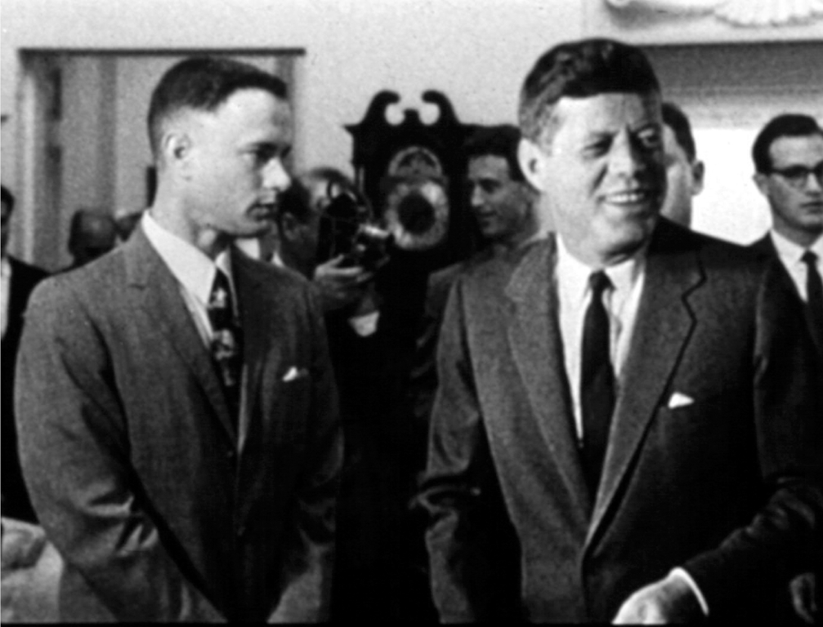
Ethics and Society
Computer ethics are the moral guidelines that govern the use of computers and information systems
Information accuracy is a concern
Not all information on the Web is correct
Pages 581 – 582
Figure 11-28

Slide 41
Ethics and Society
Intellectual property rights are the rights to which creators are entitled for their work
A copyright protects any tangible form of expression
An IT code of conduct is a written guideline that helps determine whether a specific computer action is ethical or unethical
Page 582

Slide 42
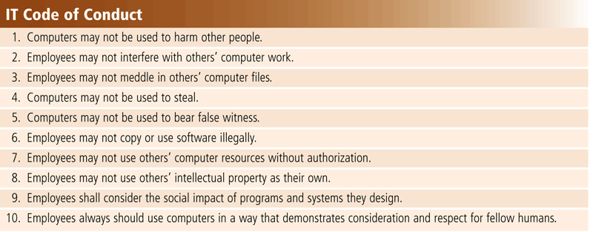
Ethics and Society
Page 583
Figure 11-29

Slide 43
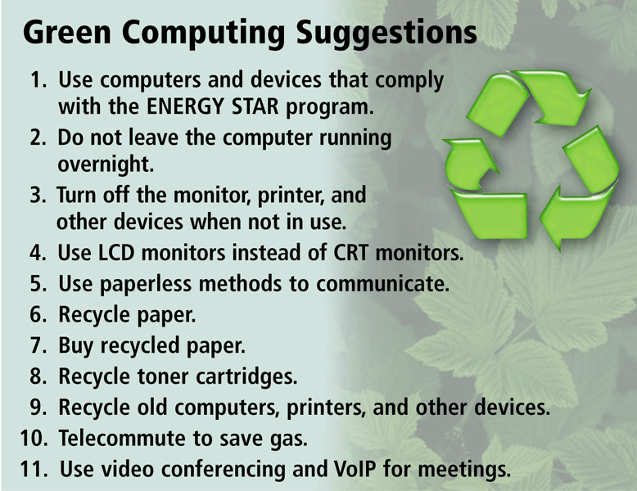
Ethics and Society
Green computing involves reducing the electricity and environmental waste while using a computer
Pages 583 – 584
Figure 11-30

Slide 44
Ethics and Society
Information privacy refers to the right of individuals and companies to deny or restrict the collection and use of information about them
Huge databases store data online
It is important to safeguard your information
Page 584

Slide 45
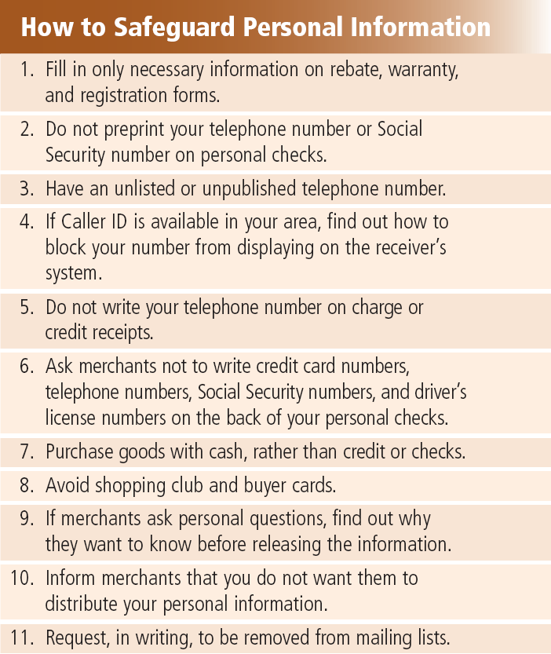
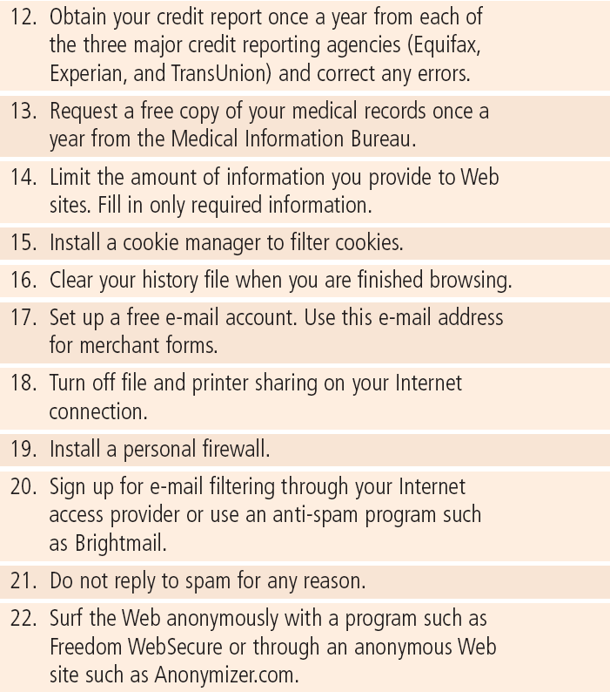
Ethics and Society
Page 584
Figure 11-31

Slide 46
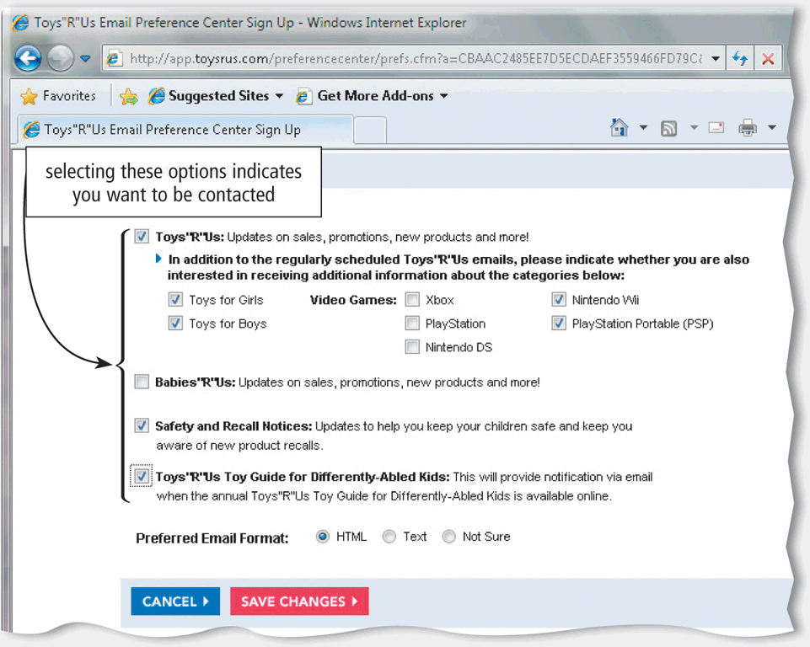
Ethics and Society
When you fill out a form, the merchant that receives the form usually enters it into a database
Many companies today allow people to specify whether they want their personal information distributed
Page 585
Figure 11-32

Slide 47
Ethics and Society
A cookie is a small text file that a Web server stores on your computer
Web sites use cookies for a variety of reasons:
Allow for personalization
Store users’ passwords
Assist with online shopping
Track how often users visit a site
Target advertisements
Pages 585 – 586

Slide 48
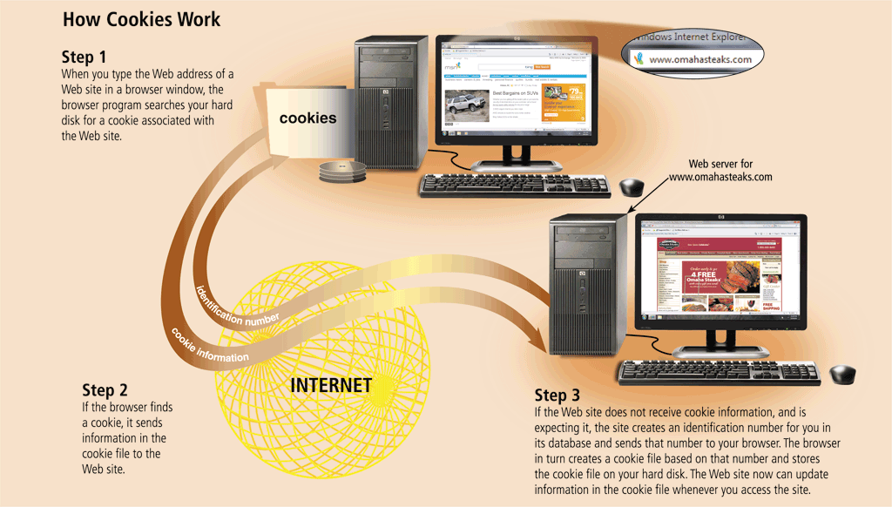
Ethics and Society
Page 586
Figure 11-33

Slide 49
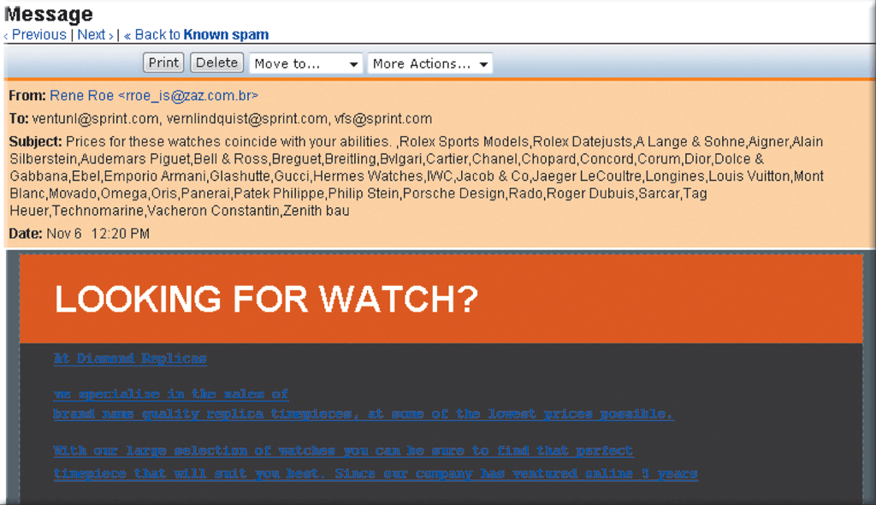
Ethics and Society
Spam is an unsolicited e-mail message or newsgroup posting
E-mail filtering blocks e-mail messages from designated sources
Anti-spam programs attempt to remove spam before it reaches your inbox
Page 587
Figure 11-34

Slide 50
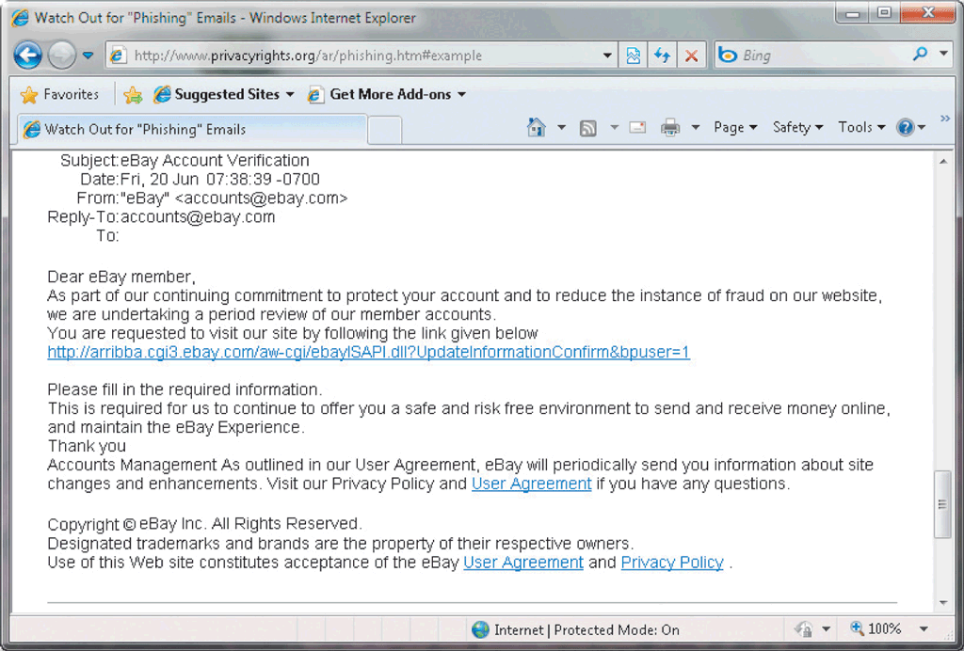
Ethics and Society
Phishing is a scam in which a perpetrator sends an official looking e-mail message that attempts to obtain your personal and financial information
Pharming is a scam where a perpetrator attempts to obtain your personal and financial information via spoofing
Pages 587 - 588
Figure 11-35

Slide 51
Ethics and Society
The concern about privacy has led to the enactment of federal and state laws regarding the storage and disclosure of personal data
See Figure 11-36 on page 589 for a listing of major U.S. government laws concerning privacy
The 1970 Fair Credit Reporting Act limits the rights of others viewing a credit report to only those with a legitimate business need
Page 588

Slide 52
Ethics and Society
Social engineering is defined as gaining unauthorized access or obtaining confidential information by taking advantage of trust and naivety
Employee monitoring involves the use of computers to observe, record, and review an employee’s use of a computer
Page 590

Slide 53
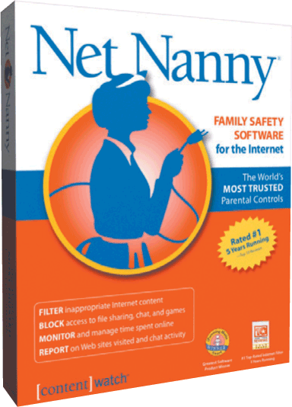
Ethics and Society
Content filtering is the process of restricting access to certain material on the Web
Many businesses use content filtering
Internet Content Rating Association (ICRA)
Web filtering software restricts access to specified Web sites
Pages 590 – 591
Figure 11-37

Slide 54
Summary
Potential computer risks and safeguards
Wireless security risks and safeguards
Computer-related health issues and preventions
Ethical issues surrounding information accuracy, intellectual property rights, codes of conduct, green computing, and information privacy
Page 591

Slide 55
Chapter 11 Complete

